Slide 1

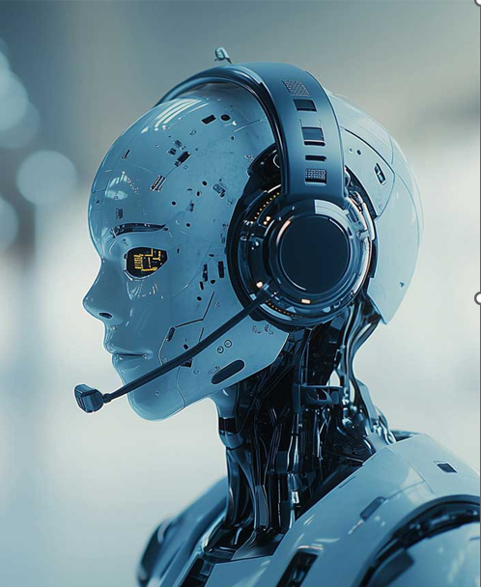
USN | NAME
2SD22CS130 | POOJA S DODDAGOUDAR
2SD23CS400 | AMBIKA T CHAVAN
2SD23CS407 | PUNARVASU SHETAKE
2SD23CS409 | SMITAL S KAGINKAR

Slide 2
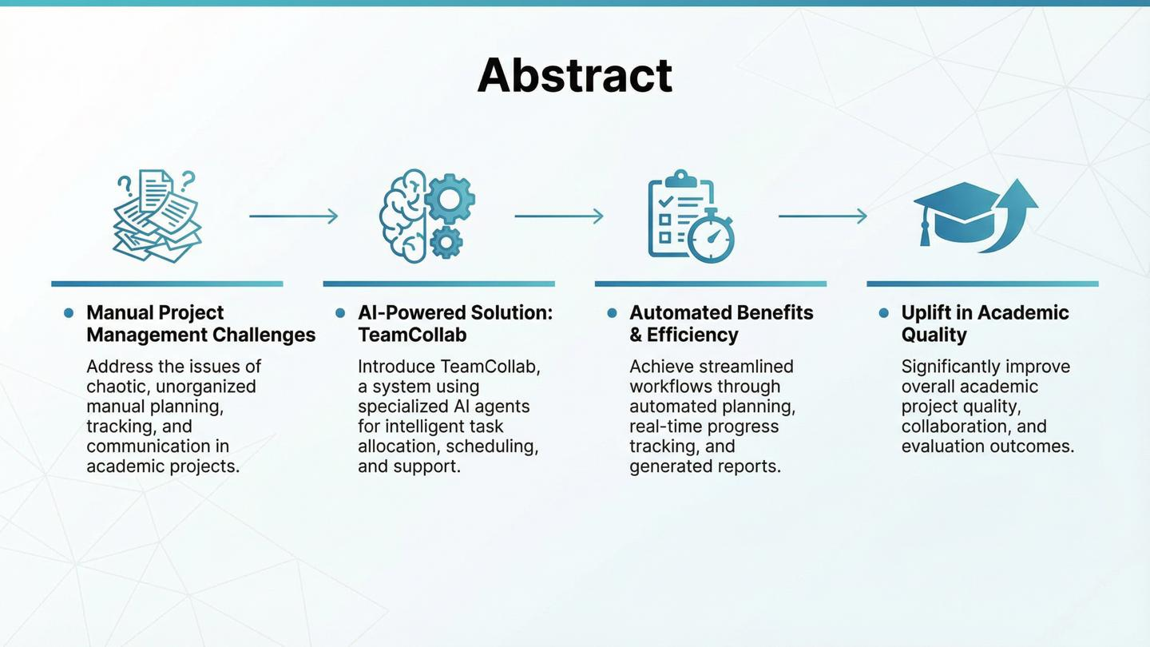

Slide 3
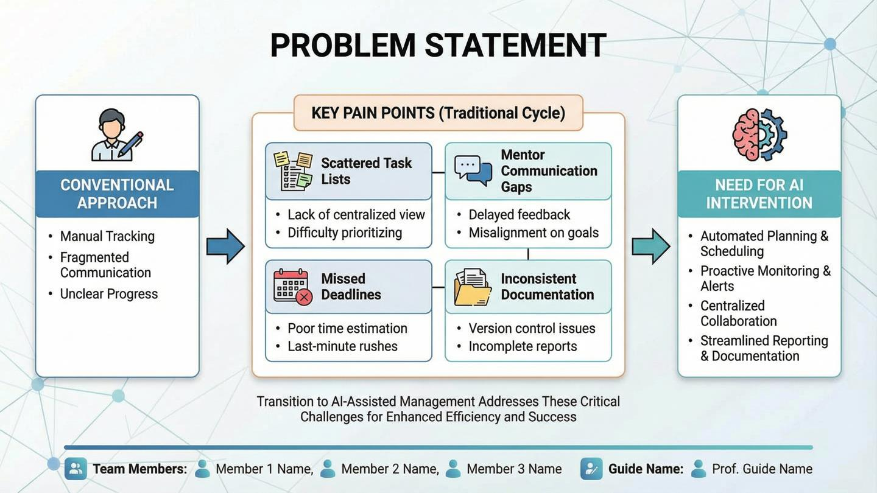

Slide 4
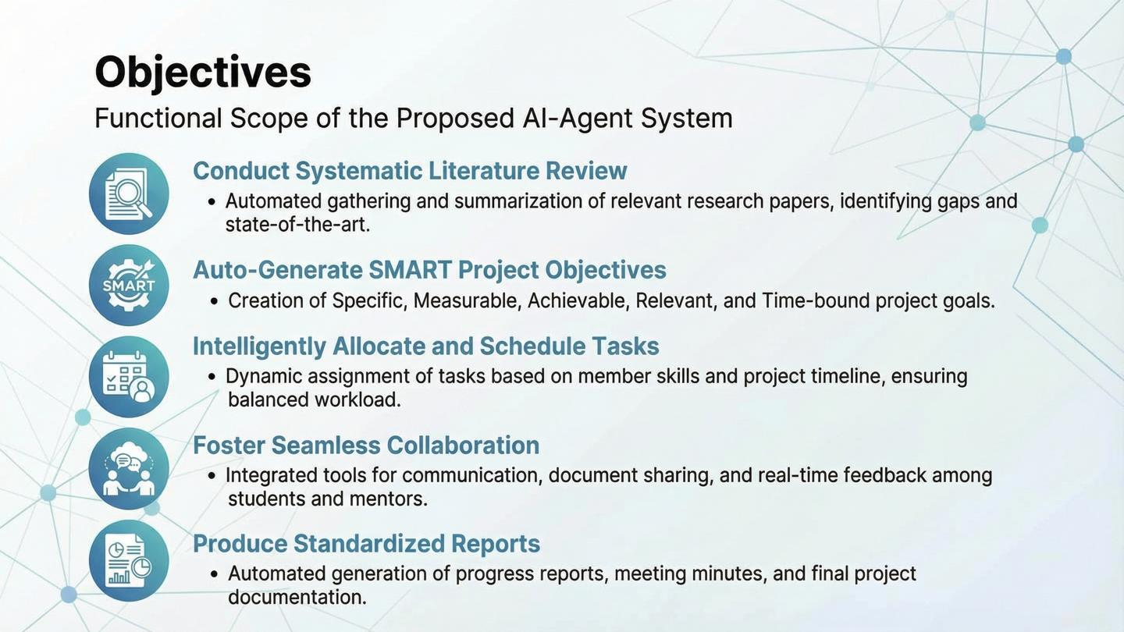

Slide 5
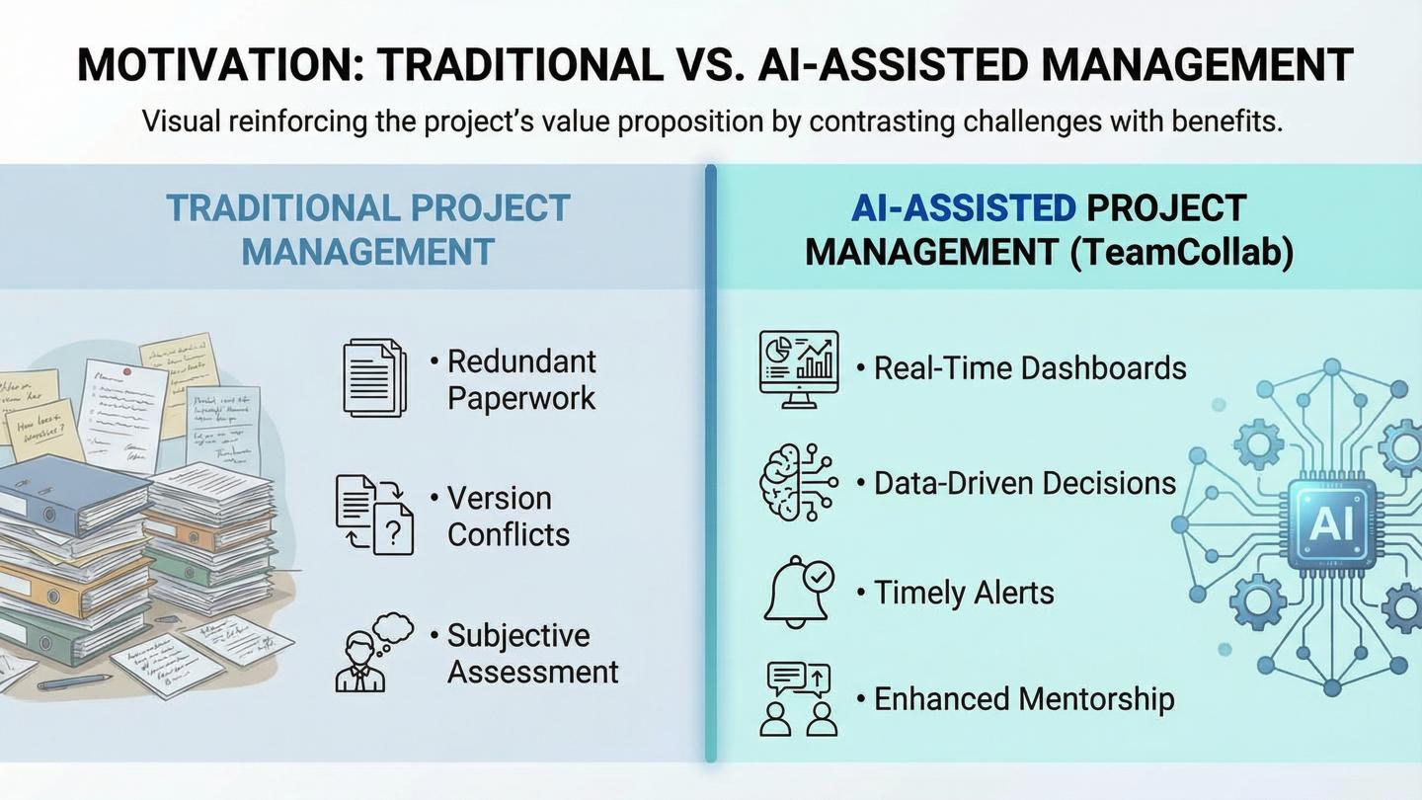

Slide 6
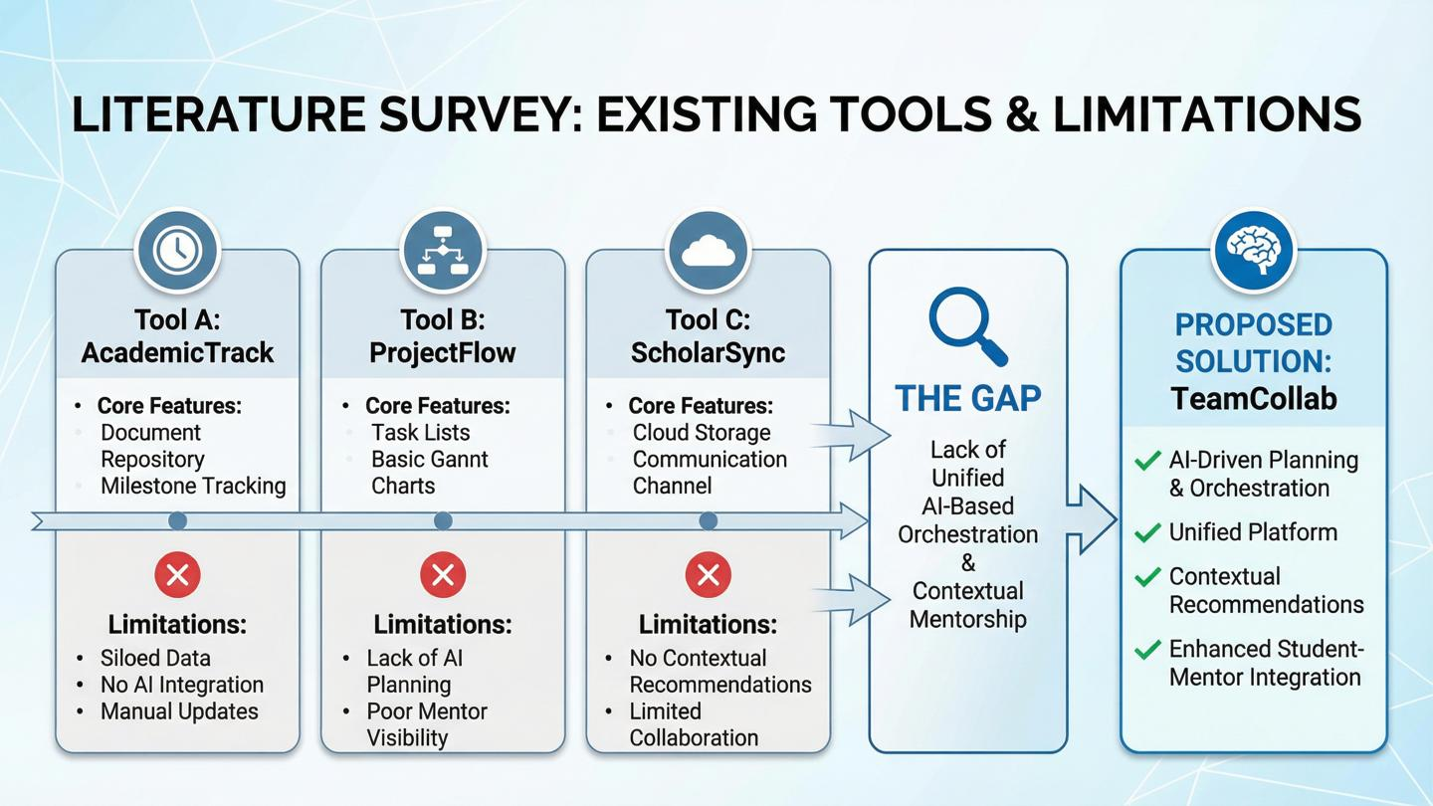

Slide 7
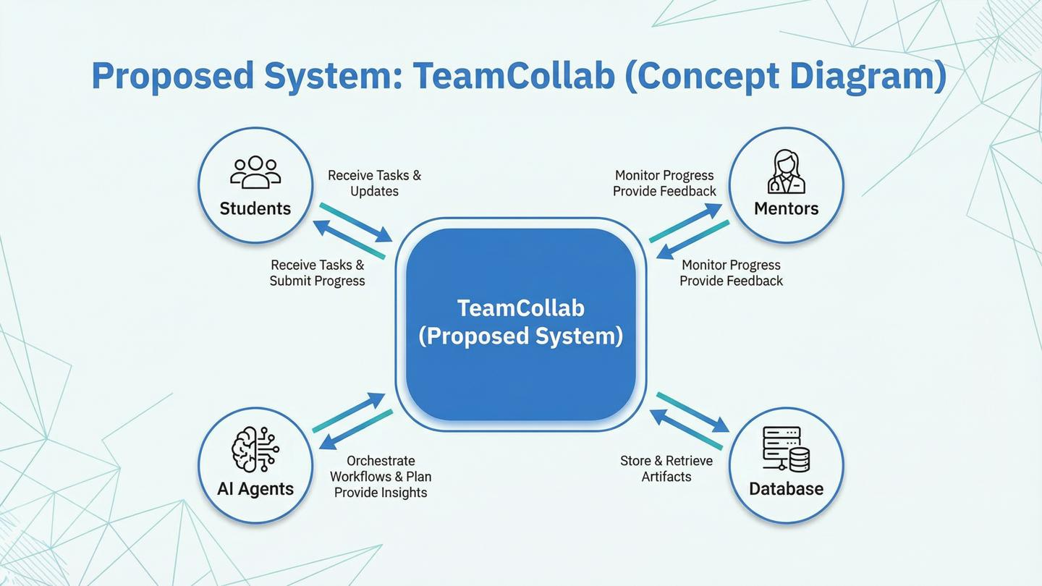

Slide 8
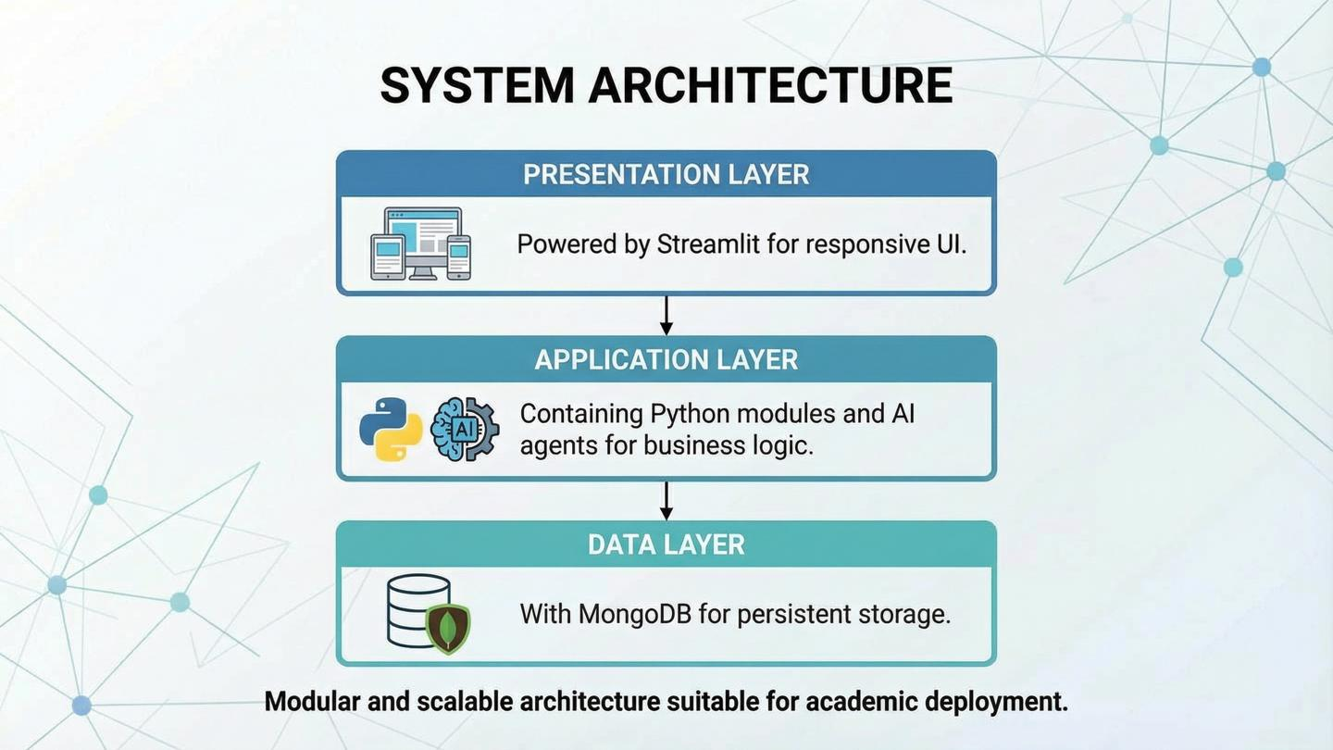
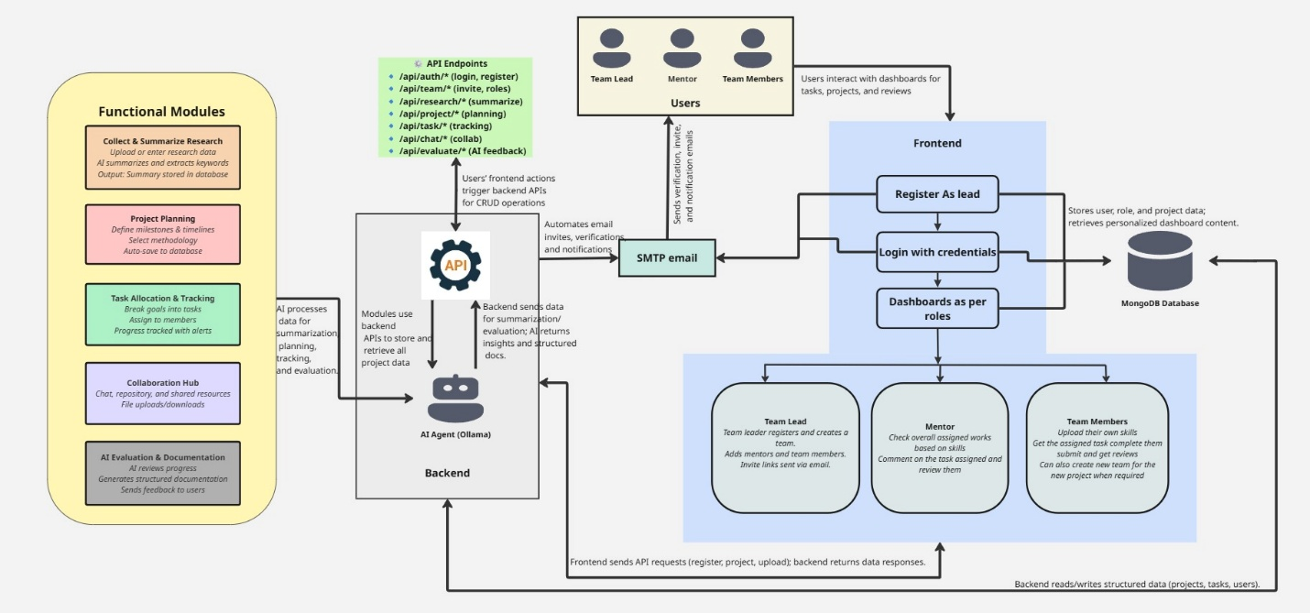

Slide 9
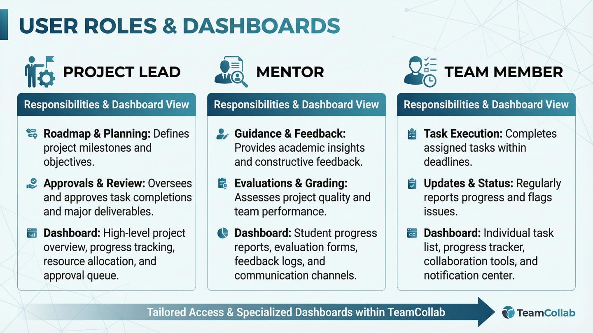


Slide 10
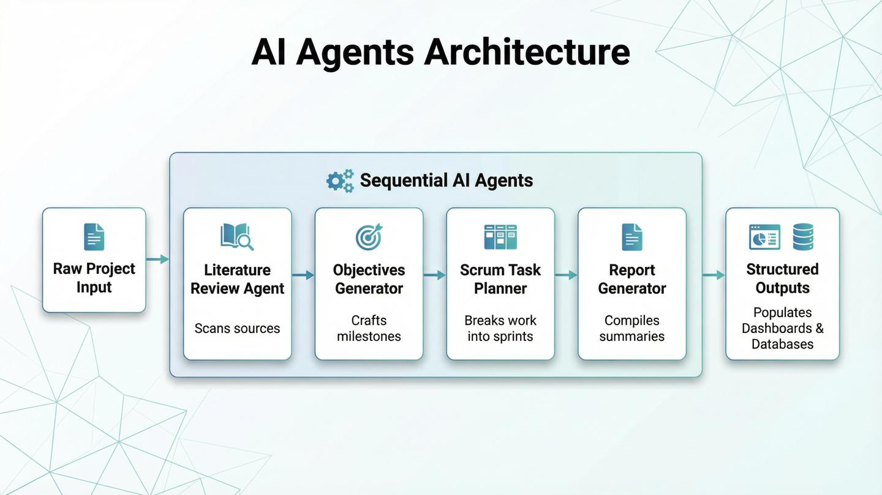

Project Flow

Slide 11
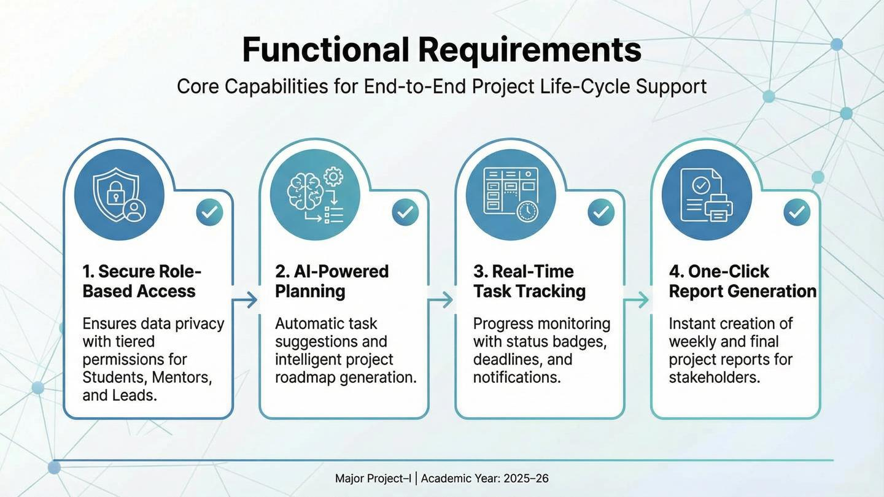

Slide 12
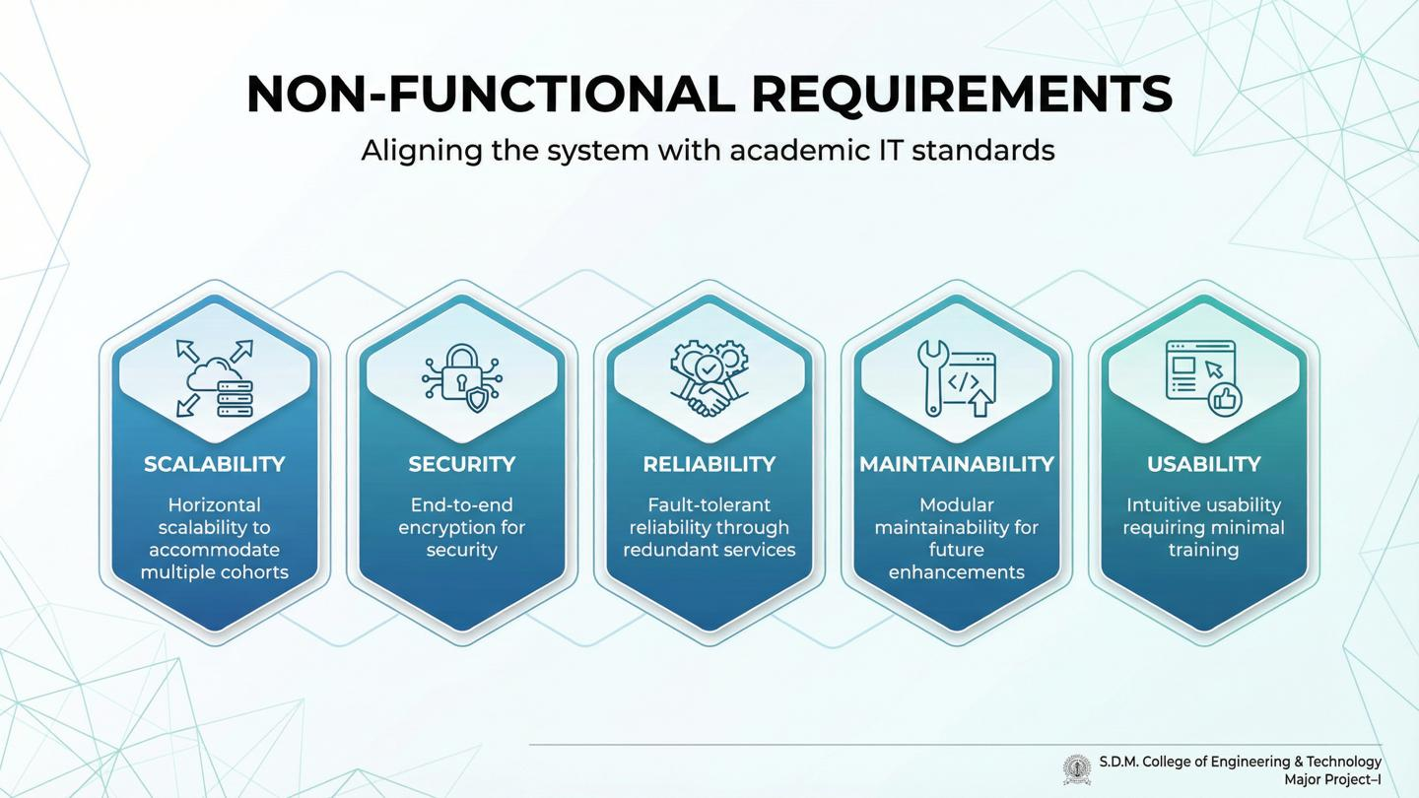

Slide 13
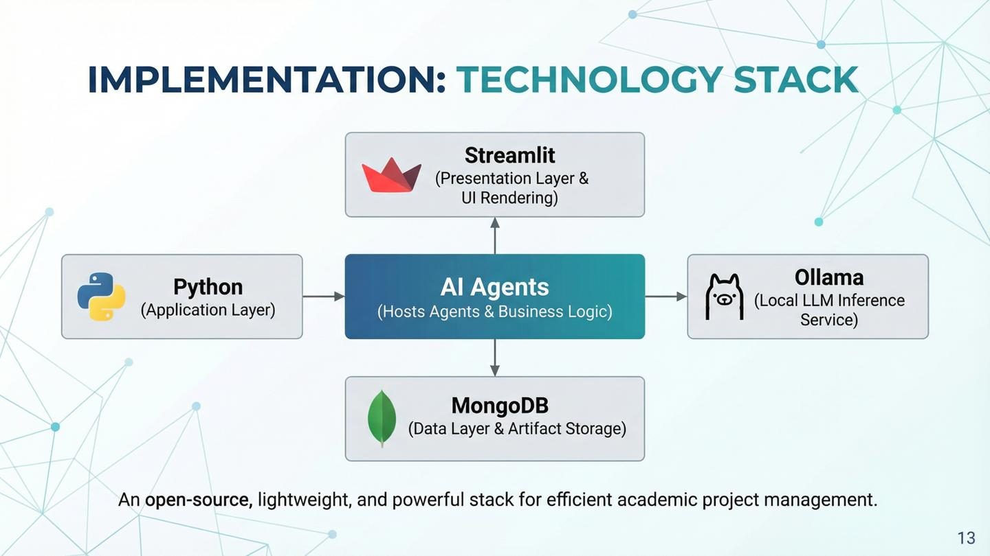

Slide 14
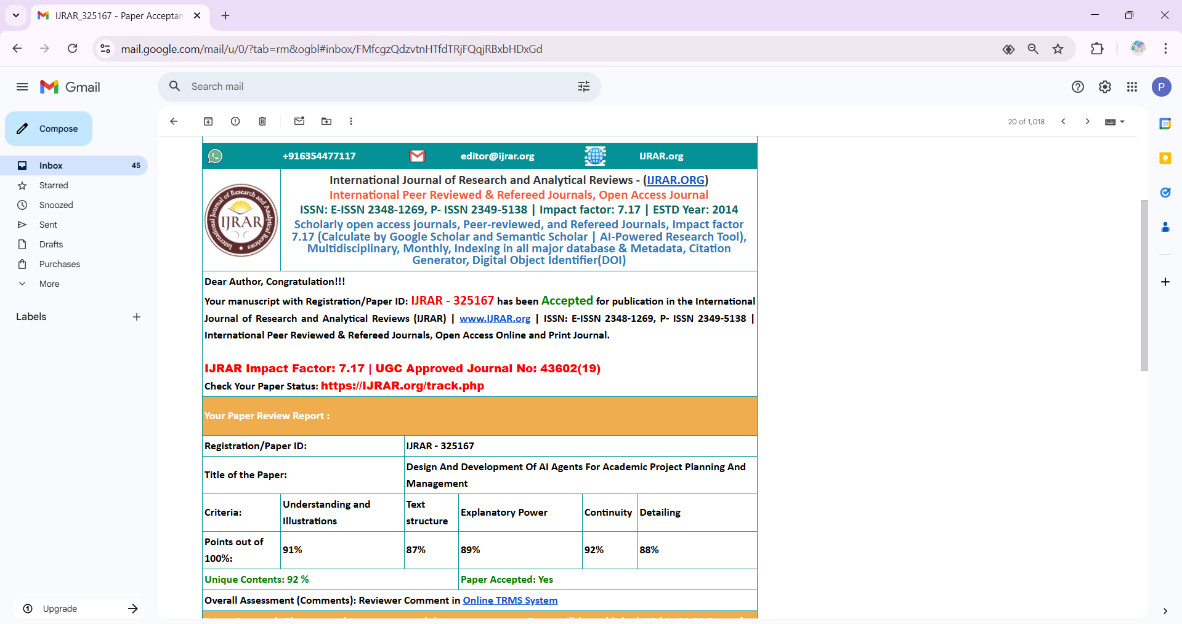

Slide 15
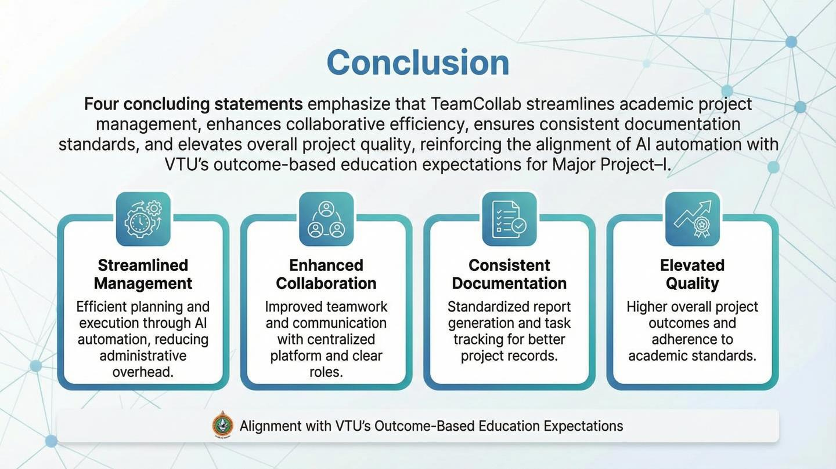



Slide 16
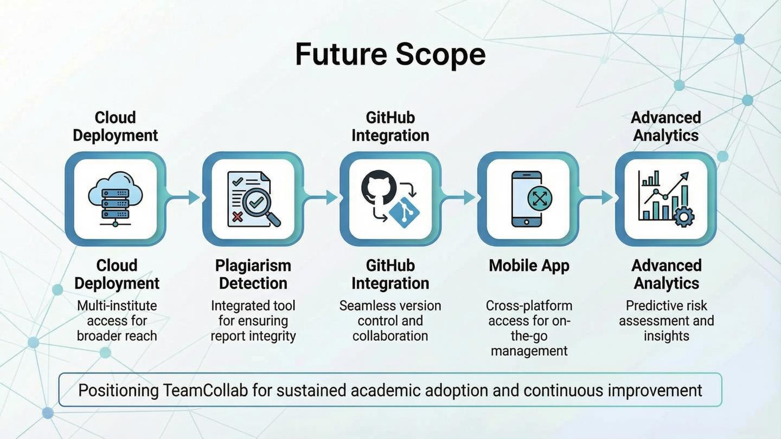



Slide 17

Thank You
THANK YOU
Questions & Discussion
Department ofComputer Science & Engineering,S.D.M.College of Engineering & Technology,Dharwad
MajorProject-I|2025-26

Slide 18
